Slide 1
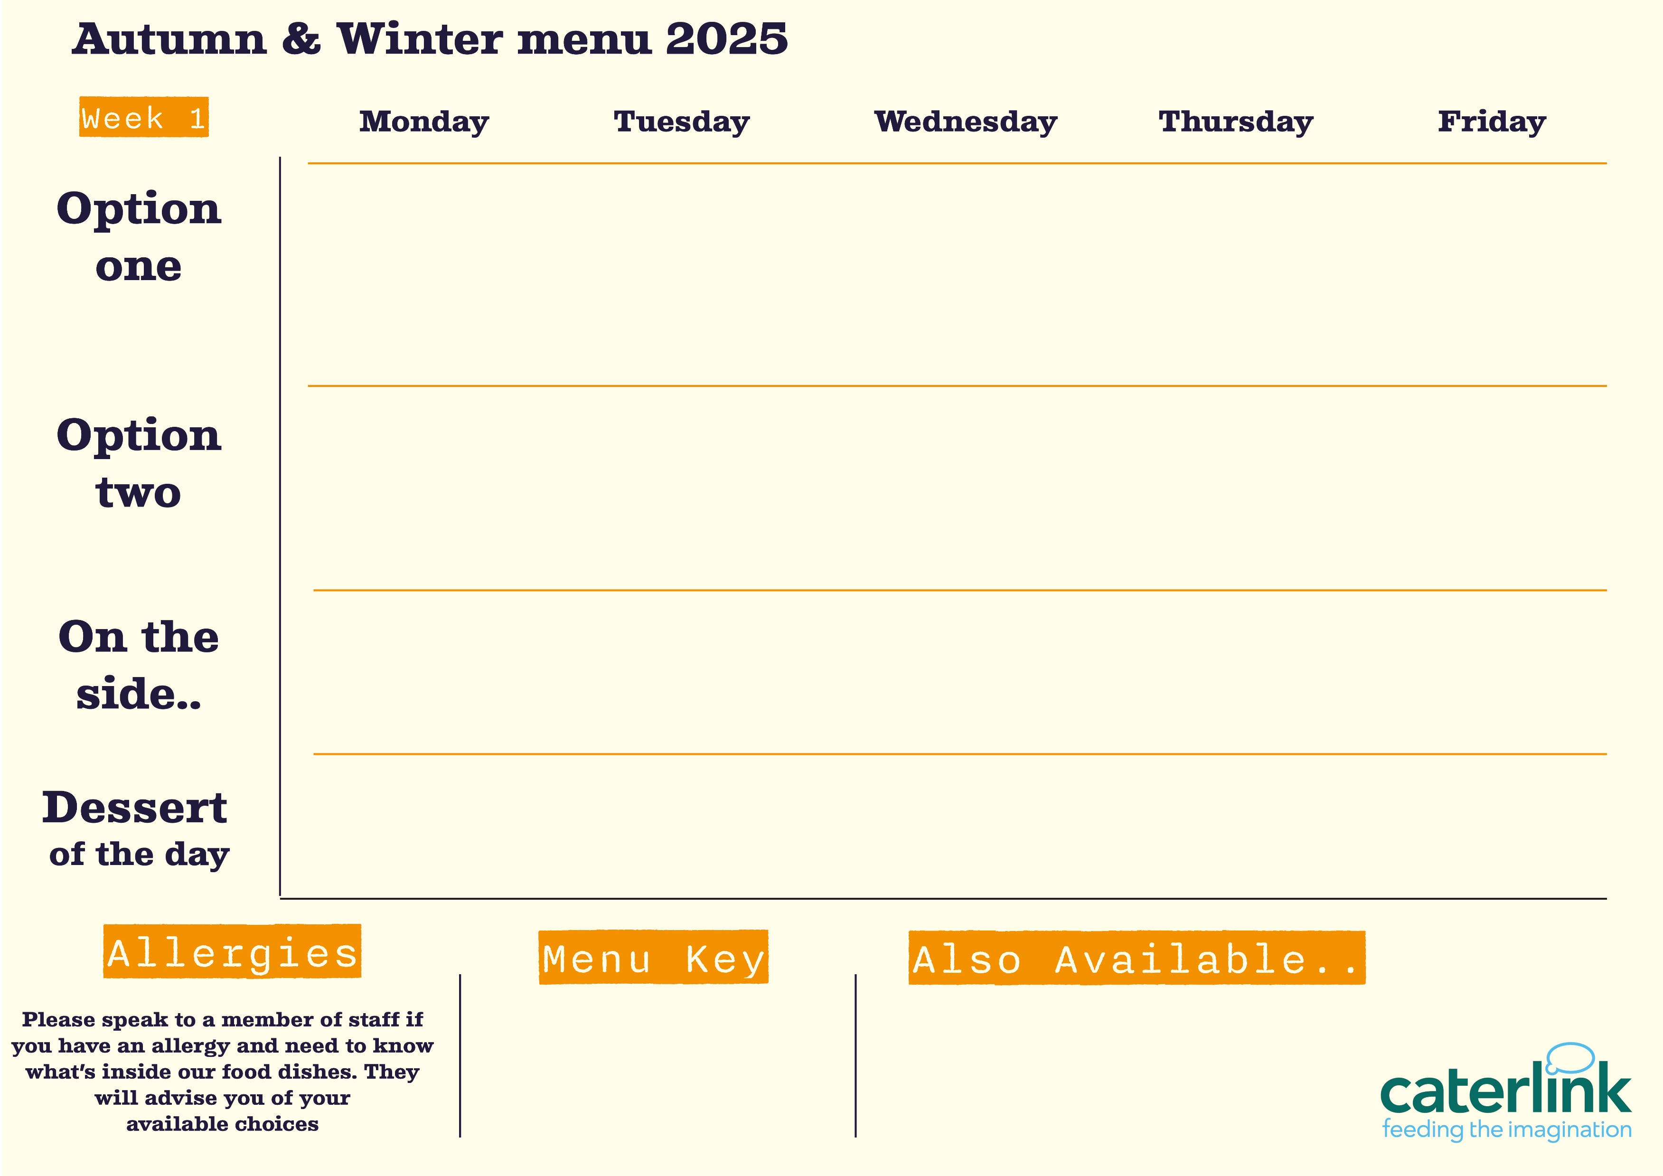









Belfast Royal Academy: Street Food
Salted Chilli Chicken
With Noodles
Beef Burrito
Or
Loaded Nachos
Wings & Wedges
With Rainbow Slaw
Pizza Market
Classic Margarite or Pepperoni
Chip Shop Friday
Fresh Pasta Bar
Daily Choice of
Sauces
Fresh Pasta Bar
Daily Choice of
Sauces
Fresh Pasta Bar
Daily Choice of
Sauces
Fresh Pasta Bar
Daily Choice of
Sauces
Fresh Pasta Bar
Daily Choice of Sauces
Chopped salad and garlic bread
Chopped salad and garlic bread
Chopped salad and garlic bread
Chopped salad and garlic bread
Chopped salad and garlic bread
Chopped fruit and home bakes
Chopped fruit and home bakes
Chopped fruit and home bakes
Chopped fruit and home bakes
Chopped fruit and home bakes
Vegan option
Fresh Sandwiches and Baguettes Made Daily
Hot Deli and Chefs Table
Meal Deals
Added plant protein
Source of wholemeal

