Slide 1
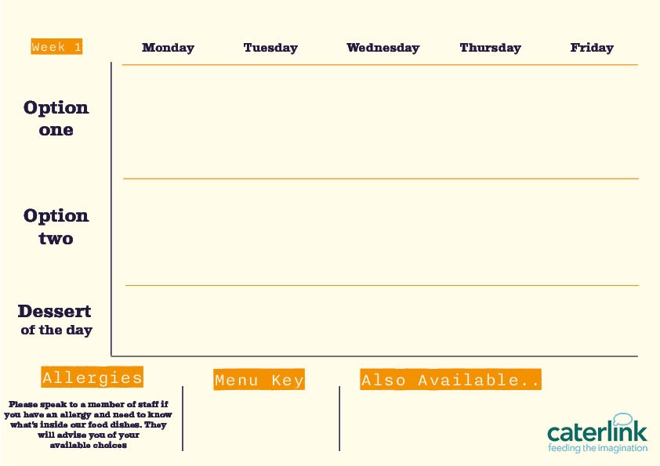







Spring Summer Menu 2026
Classic Beef Lasagne
with Garlic Bread and Chunky Roasted Summer Veg
Roast Chicken With All The Trimmings
with Roast Potatoes, Seasonal Veg and Gravy
BBQ Pulled Pork Slider
with Paprika Wedges and Slaw
Chip Shop Friday
Chip Shop Favourites Served With Chips, Peas, Curry Sauce and Gravy
Chicken Tikka Masala
with 50/50
Rice and
Sambals
Sticky Soy And Honey Noodles
With Green Beans and Paprika Wedges
Sweet Potato, Chickpea & Spinach Tikka
with 50/50 Rice
and Sambals
Vegetable Sausage Roll
with Roast Potatoes, Seasonal Veg and Gravy
Falafel Bowl
with Tabouleh, Tomato Salad, Pickles and Dips
Available Daily
Choose from - Dessert of the day – Traybakes - Cookies
Vegan option
Our hot and cold deli selection alongside soup of the day and filled jacket potatoes
Added plant protein
Source of wholemeal

Slide 2


Spring Summer Menu 2026
Smokey Beef Chilli Tacos and Wedges
with Fresh Tomato, Pineapple and Cucumber Salsa
Downtown
Dog
Topped with Tater Tots & BBQ Sauce, Sweetcorn
Chip Shop Friday
Chip Shop Favourites Served With Chips, Peas, Curry Sauce and Gravy
Jerk Chicken Thighs
with Rice & Peas, Broccoli and Spiced Pineapple Slaw
Chicken Katsu Curry
with Noodles
Butternut & Feta Quesadilla and Wedges
with Fresh Tomato, Pineapple and Cucumber Salsa
Tuscan Chickpea Pasta
with Garlic Bread
and Chunky Roasted Summer Veg
Burrito Bowl
with Rice, Charred Corn Salad, Salsa and
Sour Cream
Curried Squash & Butterbeans
with Rice & Peas, Broccoli and
Pineapple Slaw
Available Daily
Choose from - Dessert of the day – Traybakes - Cookies
Vegan option
Our hot and cold deli selection alongside soup of the day and filled jacket potatoes
Added plant protein
Source of wholemeal

Slide 3



Spring Summer Menu 2026
Meatballs In Tomato Sauce
with Garlic Bread, Spaghetti
Mac and Cheese with Toppings
Croutons, Pepperoni Pieces, Crispy Onions, Spring Onions, Barbecue Beans
Chip Shop Friday
Chip Shop Favourites Served With Chips, Peas, Curry Sauce and Gravy
Original Spice Chicken
with Spicy Rice and Rainbow Slaw
Chicken
Biryani
with Sambals
Yakisoba Soya
Noodles
with Stir Fry with Edamame Beans
Vegetable Biryani
with Sambals
Smokey Bean
Burger
with Spicy Rice and Rainbow Slaw
Available Daily
Choose from - Dessert of the day – Traybakes - Cookies
Vegan option
Our hot and cold deli selection alongside soup of the day and filled jacket potatoes
Added plant protein
Source of wholemeal

